Slide 1
Welcome!

Slide 2
Word riddles
0.1: Forward I am heavy, but backward I am not. What am I? (7)
0.2: What word is pronounced the same if you take away four of its five letters? (5)

Slide 3
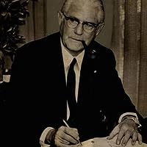
Wolf among the Sheep
Who will be the most unique snowflake of the group?
Alone in 1st place: 4pts
Tied for 1st place: 3pt each
Anything other than 1st place: 2pt
"It is better to walk alone, in the right direction, than to follow the crowd, going nowhere." - Maxwell Maltz

Slide 4
1.1: Which word was not on the previous slide?
A: Snowflake
C: Word
B: Direction
D: Alone

Slide 5
1.2: x = (3*4)/12+2
A: 3
C: 0.857...
B: 14
D: x

Slide 6
1.3: Best repo?
A: Stratus
C: eKiss
B: Rain
D: Tools
E: Documentation

Slide 7
1.4: How many points do you want?
A: 4
C: 3
B:
D: Magenta

Slide 8
1.5: What does water taste like?
A: I don’t know
C: Green
B: Not coffee
D: Magenta

Slide 9
1.6: are you a Wolf or a Sheep?
A: Wolf
C: Sheep
B: Both
D: Neither
E: Human

Slide 10
Wipeout round!
Binary answers, questions increasing in difficulty. Each incorrect answer halves score.
What is the most common hair/eye colour combination worldwide
What month had the highest rainfall in the UK in 2022 (Oct/Feb)

